Slide 1
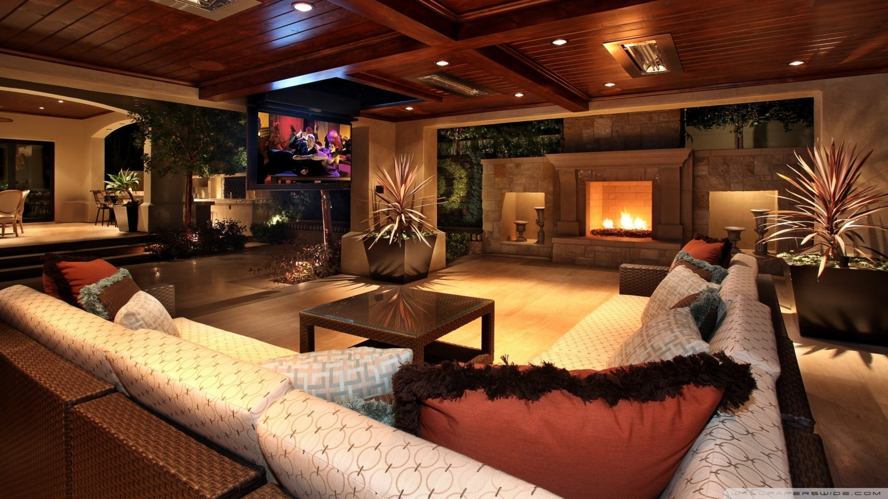
Presented By:
D-DARSHAN AND TOUR
Presented By:
Group no-(91)
1)Prashant Sawant
2)Roshan Kanwade

Slide 2
INTRODUCTION:
Welcome to our web application for hotel booking near temples. Our application is designed to provide a convenient and hassle-free experience for those seeking
accommodation near their preferred temple. With our user-friendly interface,
users can easily search for hotels located in close proximity to their desired temple, compare prices, and make reservations quickly and securely.
Our application offers a wide range of accommodation options, from budget-friendly to luxurious amenities, and customer ratings. Our platform also features detailed hotel descriptions and photos, allowing users to make an informed decision before making a reservation.

Slide 3
OBJECTIVE:
The objective of our hotel booking near temple web application is to provide a
user-friendly platform for individuals and families seeking accommodation near
their preferred temple. Our goal is to make the process of booking hotels near
temples convenient, easy, and hassle-free.
Our ultimate objective is to create a valuable tool that helps users save time and effort while finding the perfect hotel for their next temple visit.

Slide 4
SCOPE:
The scope of our hotel booking near temple web application is to provide a
user-friendly platform for individuals and families seeking accommodation
near their preferred temple. The application will allow users to search for
hotels based on filter like places and make secure bookings with multiple
payment options. The application will have a relation between the user and
the booking system, allowing users to manage their bookings easily.

Slide 5
TECHNOLOGY USED:
Frontend technologies:
HTML5
CSS3
JavaScript
React (or other JavaScript framework/library)
Redux,Jquery (or other state management tool)
Backend technologies:
Spring Boot
Hibernate
Spring Data JPA
RESTful API design
Data Storage:
MySQL
Other technologies/tools:
Git
GitHub
Swagger
Postman

Slide 6
SOFTWARE AND HARDWARE CONFIGURATION:
Software Configuration:
Operating System: You can choose any operating system for web app development like Windows, Linux, or MacOS.
Web Server: A web server like Apache or Nginx to host your web application.
Database Management System: A database management system like MySQL.
Payment Gateway Integration: Payment gateway integration like Stripe.
Cloud Hosting: Cloud hosting services like AWS, Google Cloud, or Microsoft Azure.
Hardware Configuration:
Processor: Intel Core i5 or higher processor.
RAM: At least 4 GB of RAM.
Storage: At least 256 GB of SSD storage.
Display: A high-resolution monitor with at least 1920 x 1080 resolution.
Internet Connection: A high-speed internet connection with at least 5 Mbps download and upload speeds.

Slide 7
FUNCTIONALITIES:
Admin : Admin can manage hotel listings, user accounts, room inventory, bookings, payment, and reports. Admin can also view the statistics and analytics of the web app.
Hotel Owner : Hotel owners can register their hotels, manage room inventory, update room prices and availability, view bookings, and generate reports.
User : Users can create an account, search for hotels, view hotel details, check room availability, book rooms, make payments, and cancel bookings.

Slide 8
Payment Gateway : Payment gateway integration is essential for processing payments securely and efficiently.
Notification : Notification module sends emails to users, hotel owners, and admins for booking confirmation, payment status and cancellations.
In summary, the hotel booking web app provides functionalities for admins, hotel owners, and users to manage hotel listings, room inventory, bookings, payments, notifications, and analytics.

Slide 9
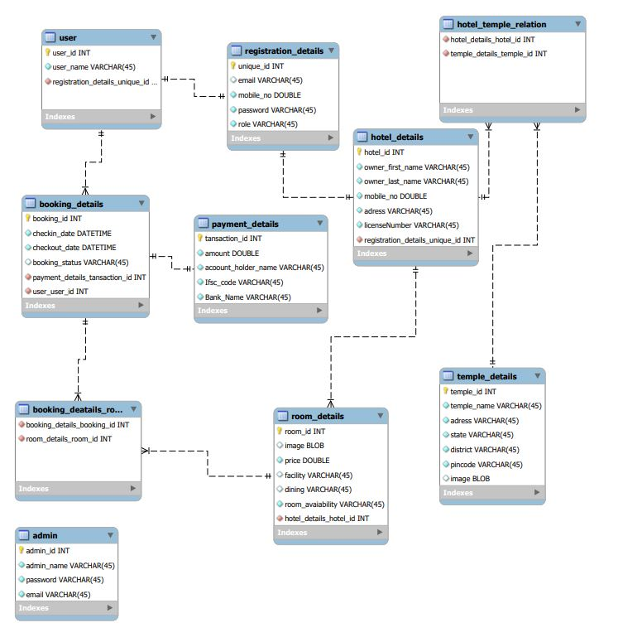
Daigrams:
ENTITY RELATION DAIGRAM:

Slide 10
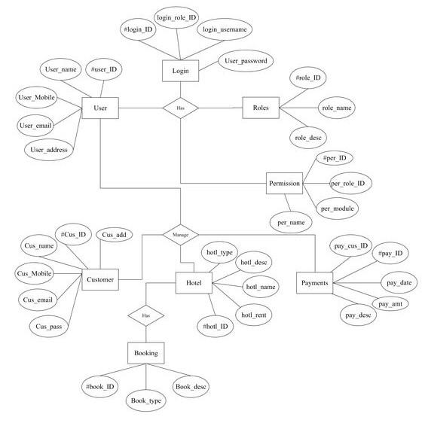

Slide 11
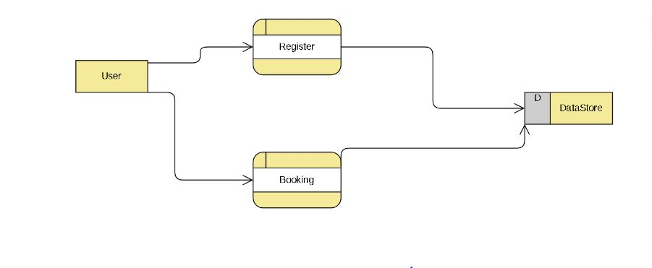
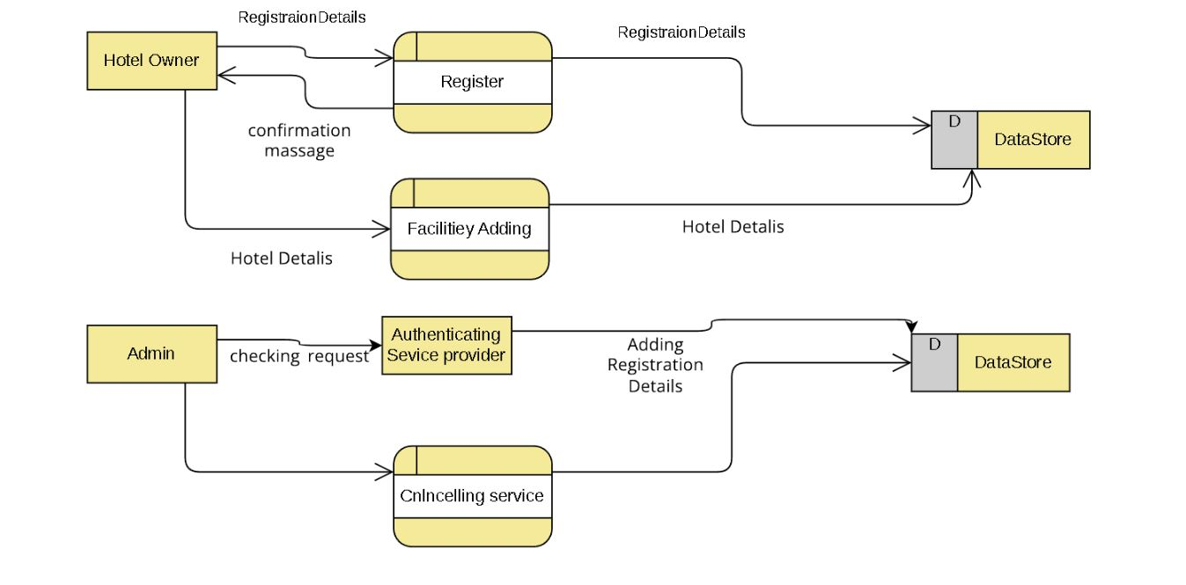
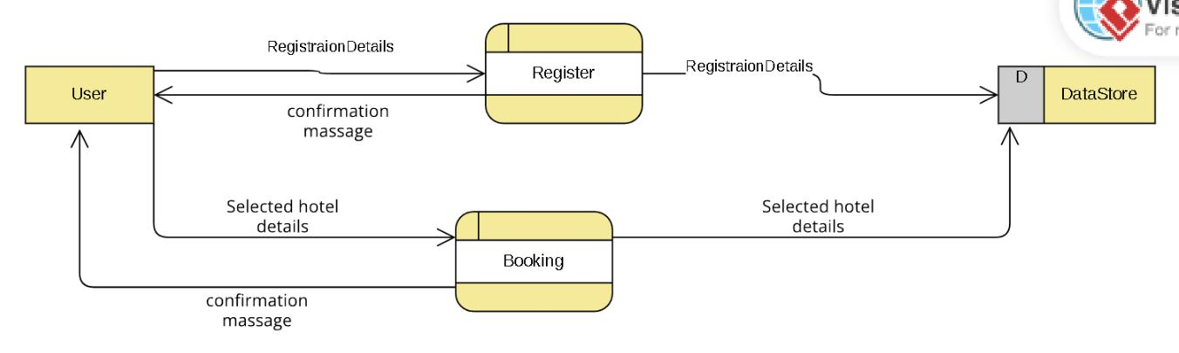
DFD:

Slide 12
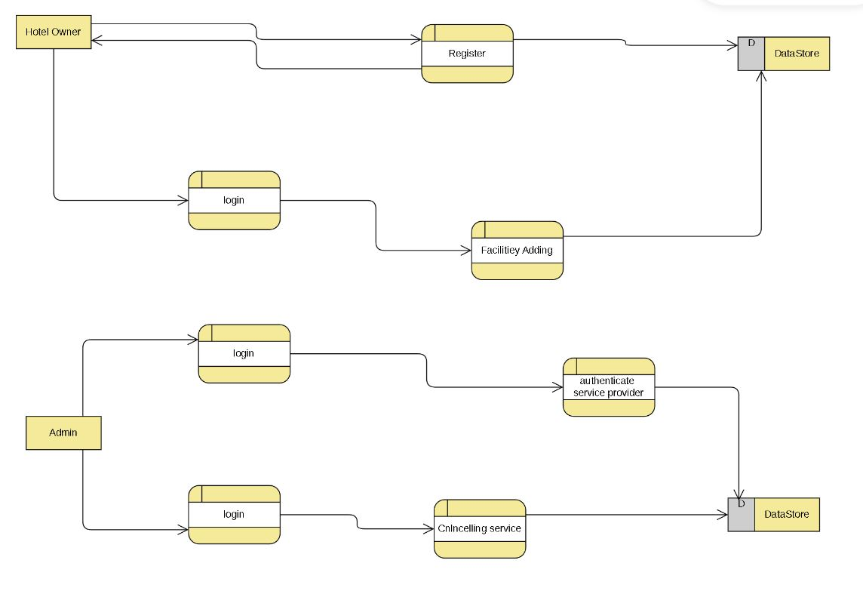

Slide 13
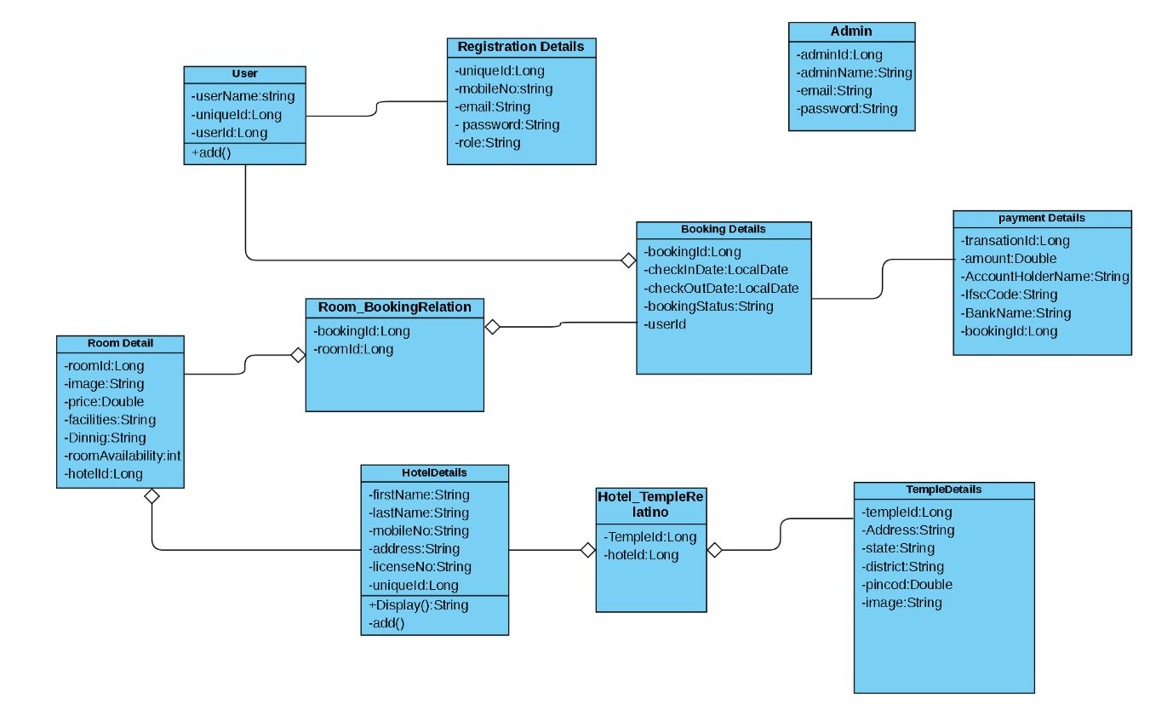
CLASS DAIGRAM:

Slide 14
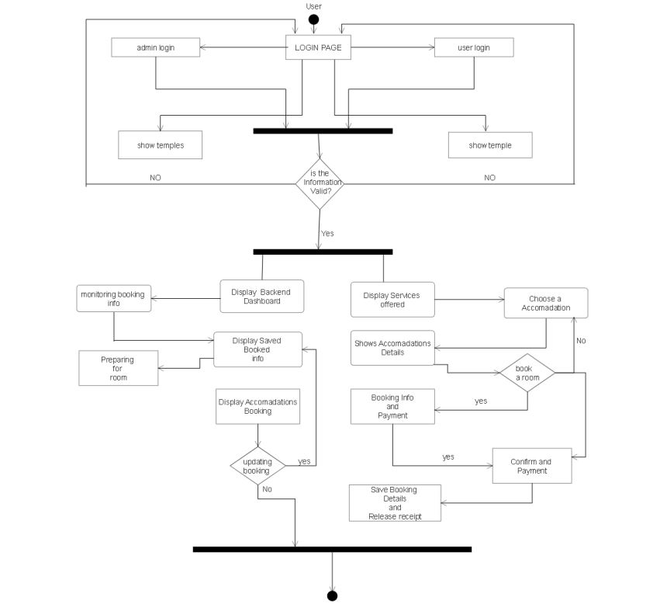
ACTIVITY:

Slide 15
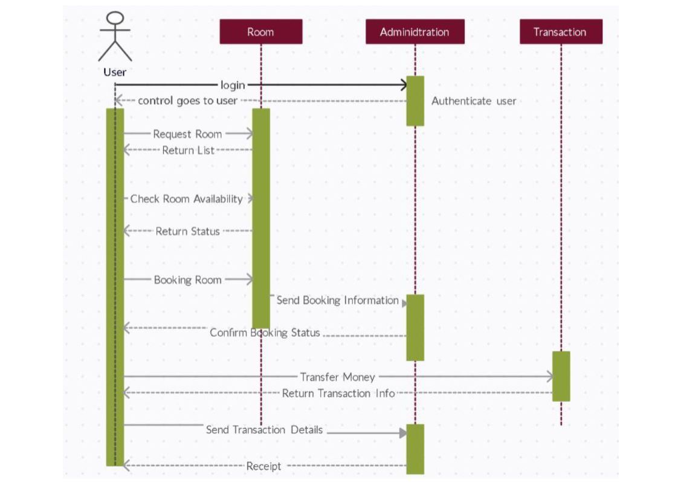
SEQUENCE:

Slide 16
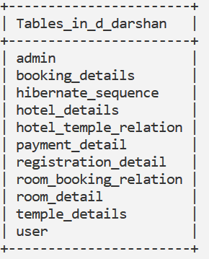
DataBase Design:
TABLE STRUCTURE:
Tables:

Slide 17
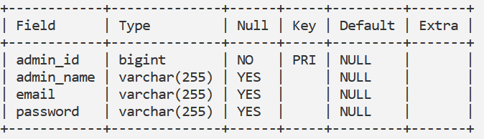
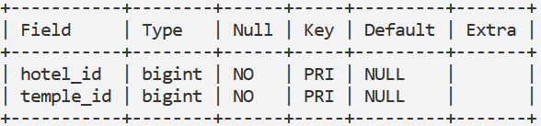
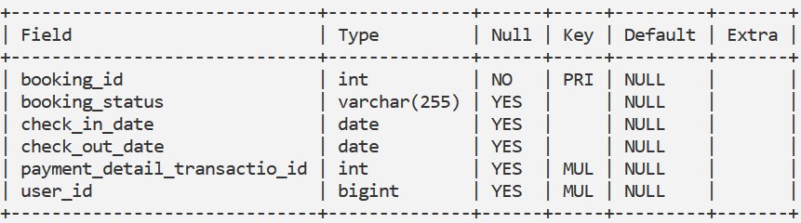
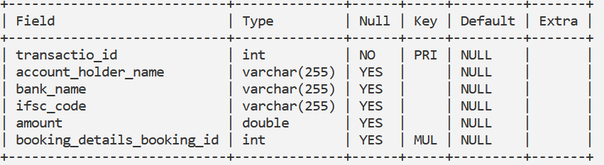
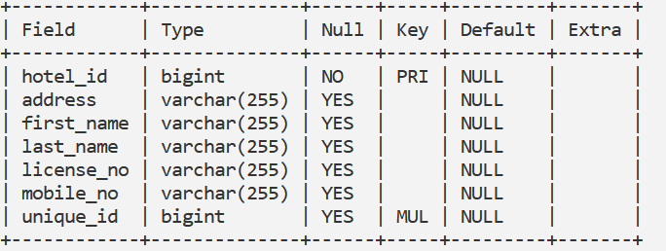
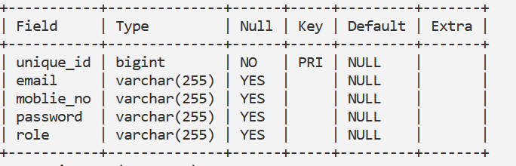
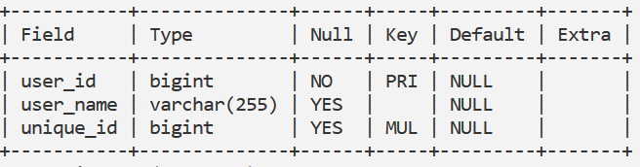
Hotel_Temple_Relation:
Admin:
BookingDetails:
Payment_Details:
HotelDetails:
Registration_Details:
User:

Slide 18
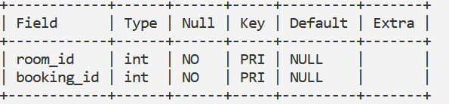
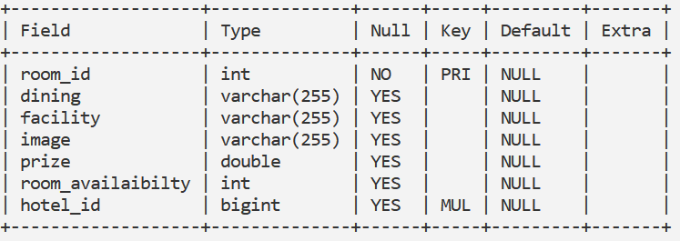
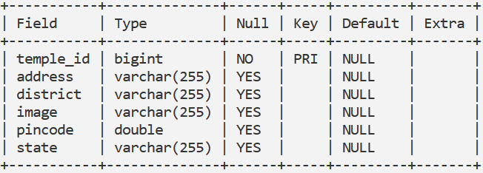
Room_Booking_Relation:
Room_Details:
User:
Temple_Details:

Slide 19
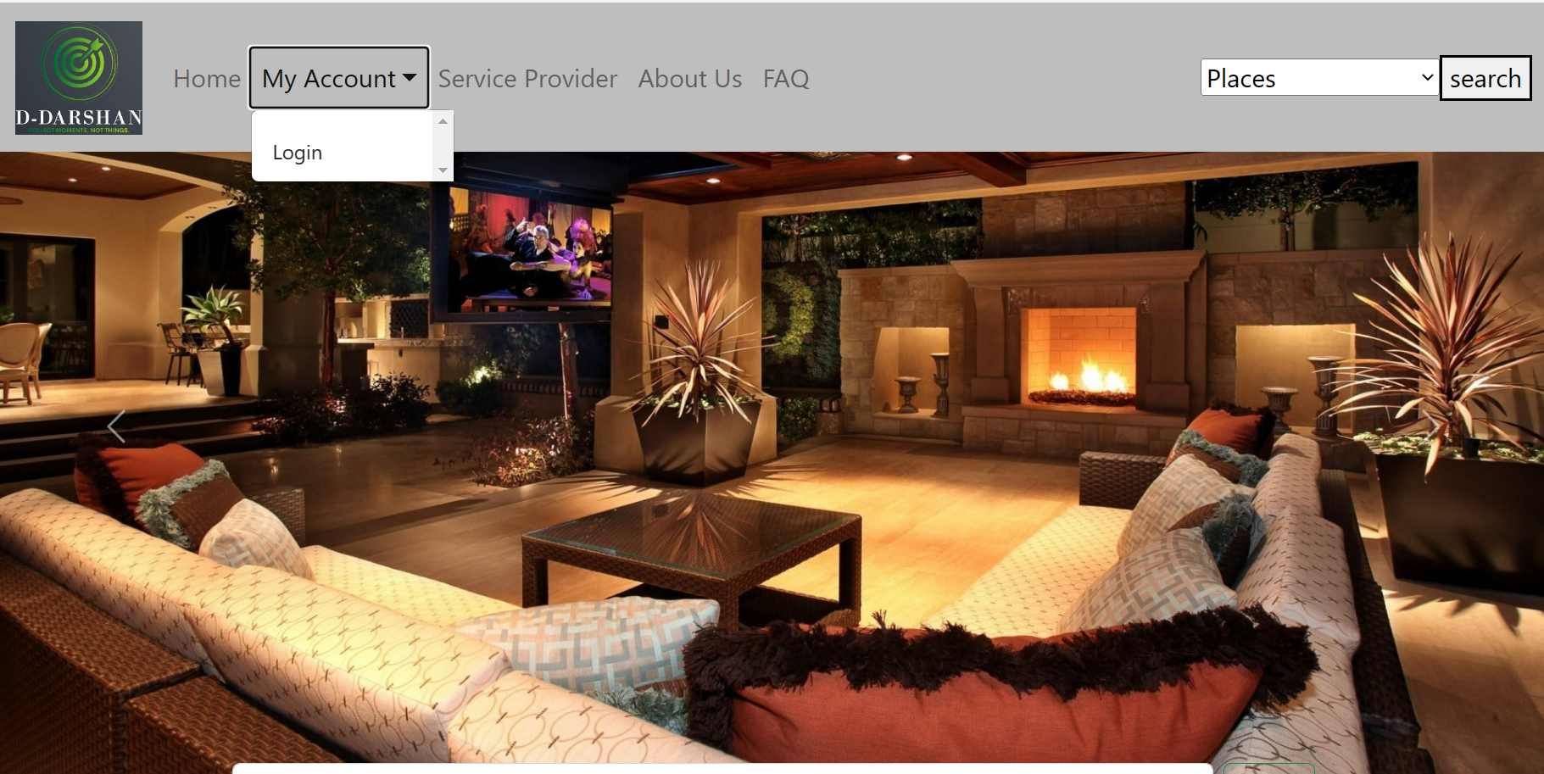
PROJECT DAIGRAMS:

Slide 20
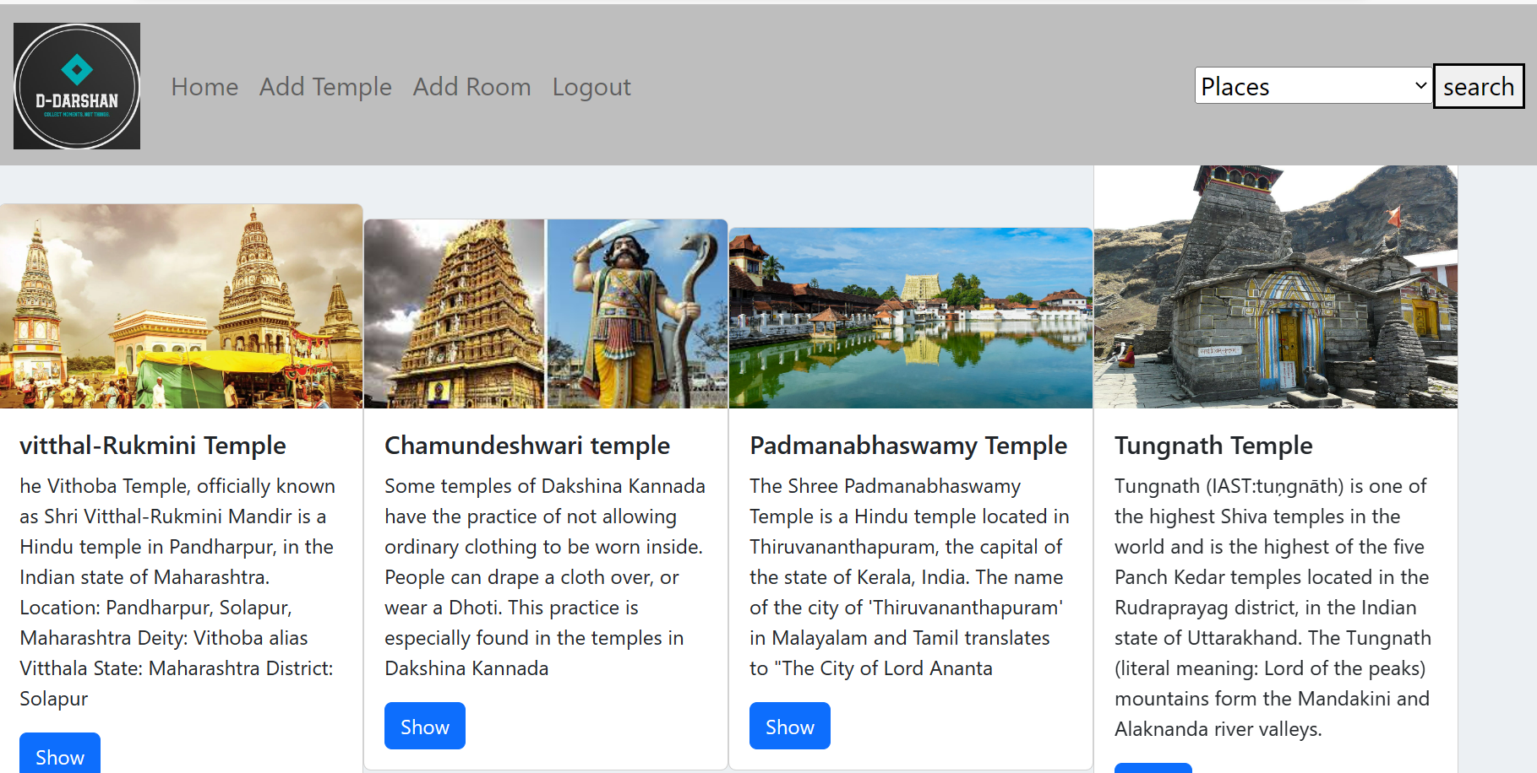

Slide 21
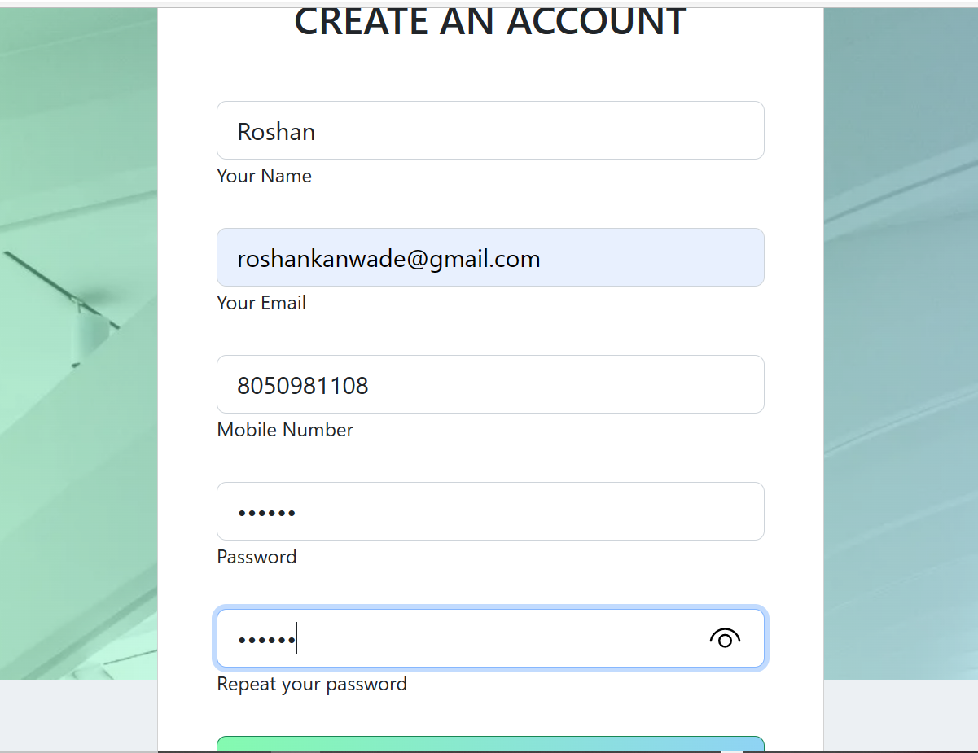
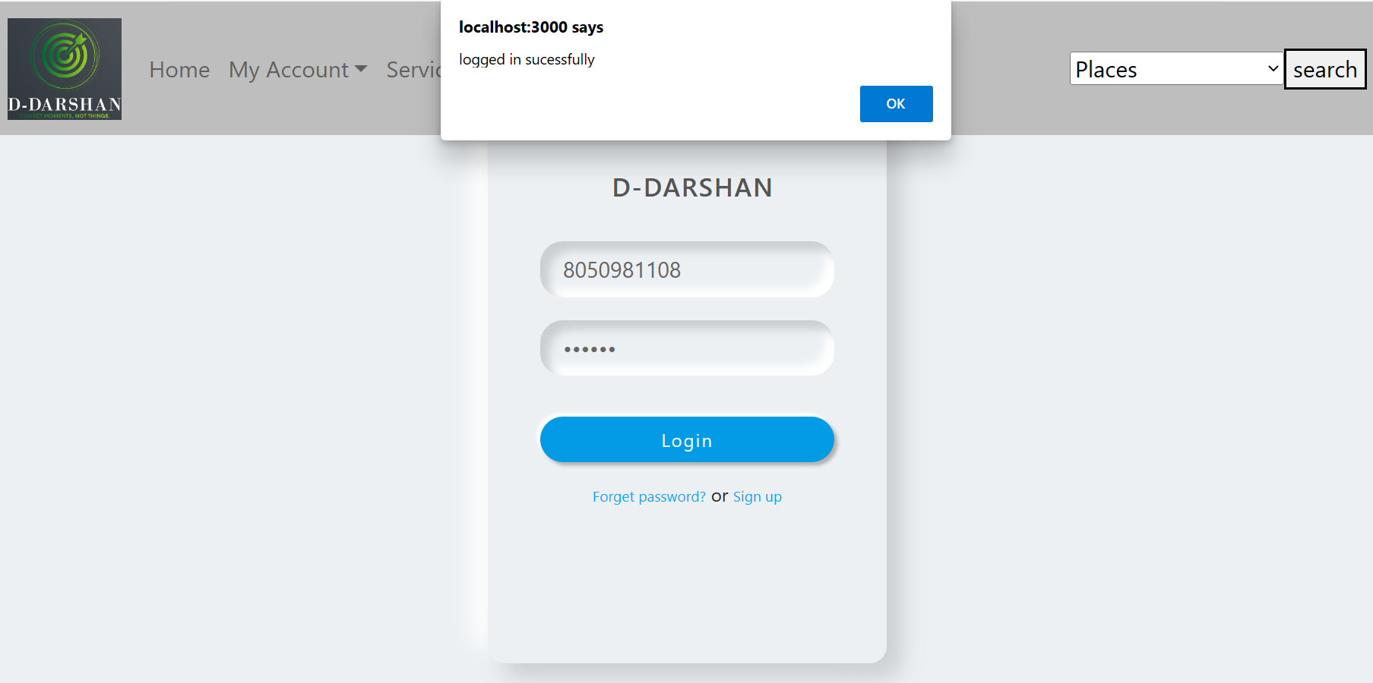

Slide 22
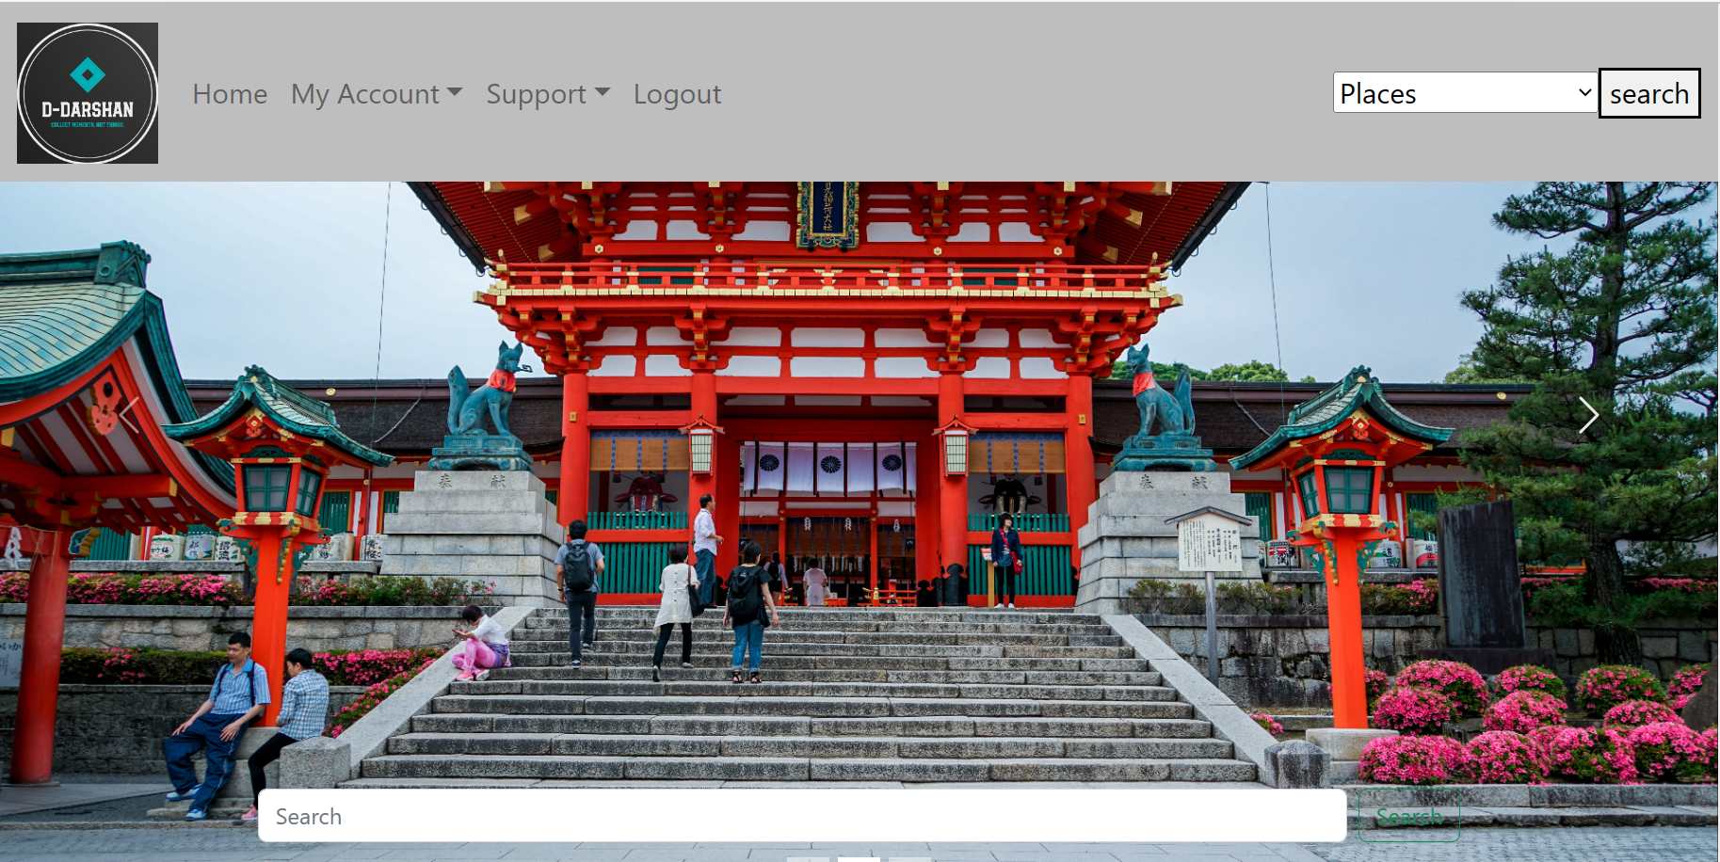
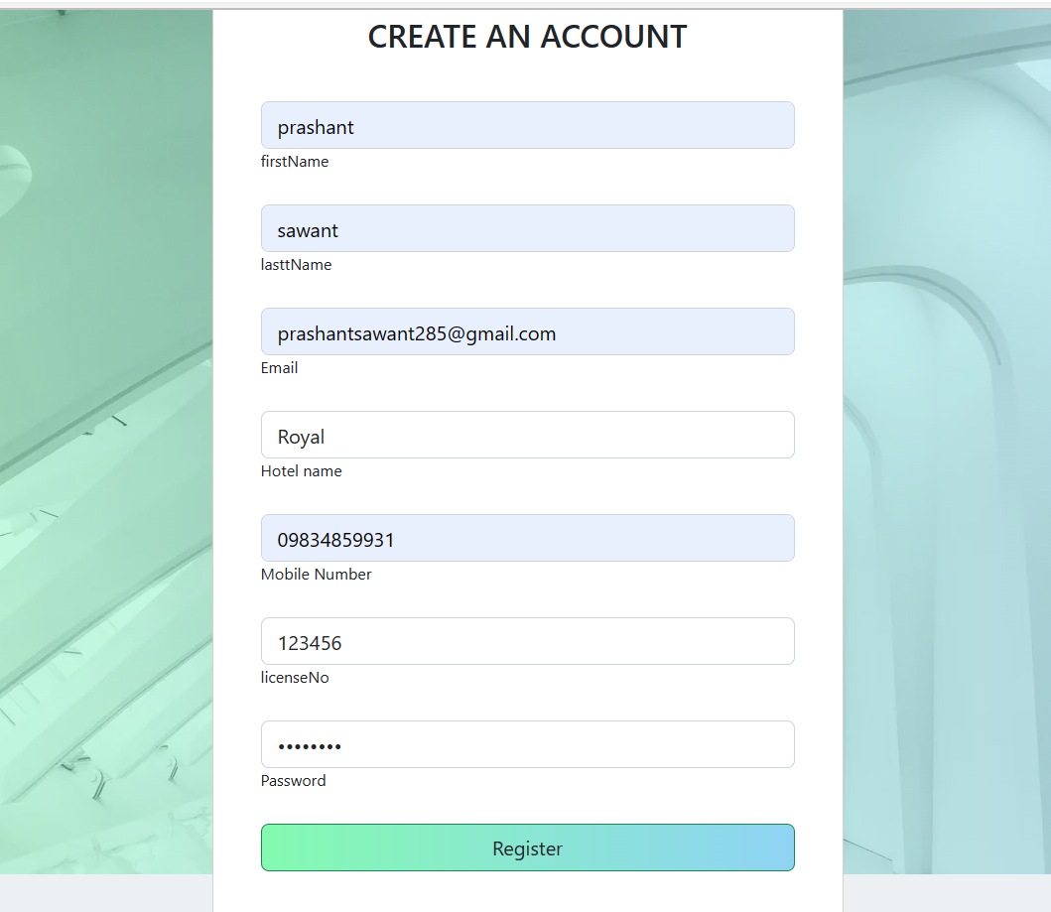

Slide 23
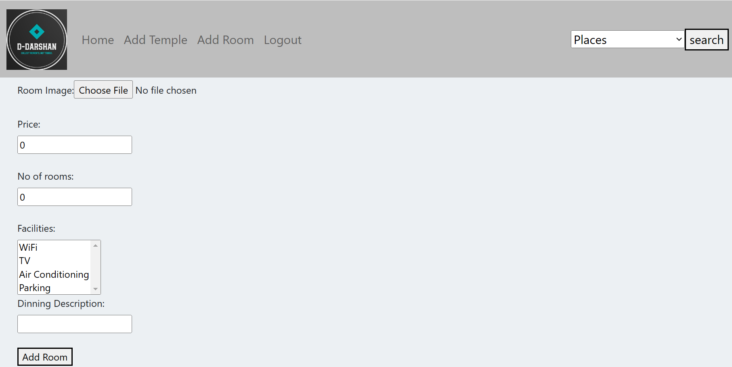
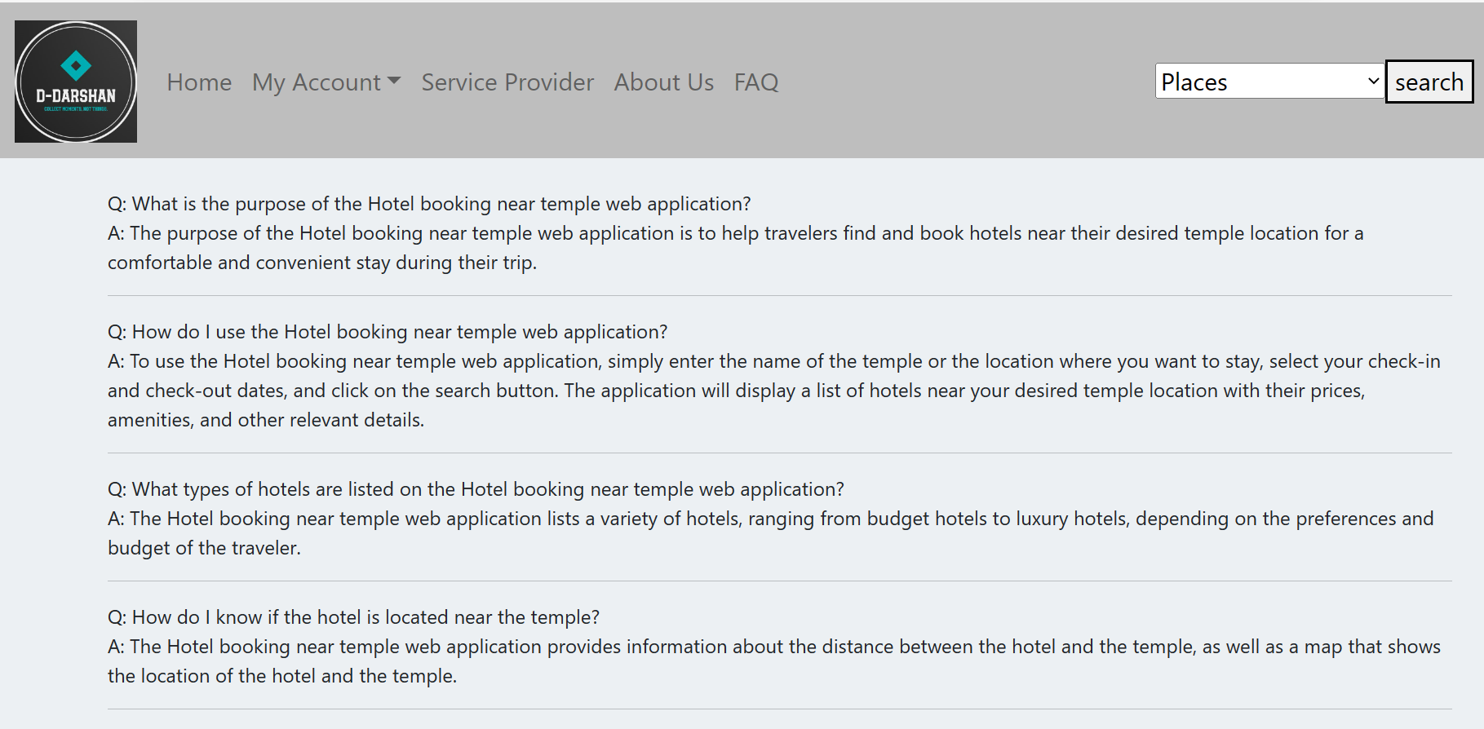

Slide 24
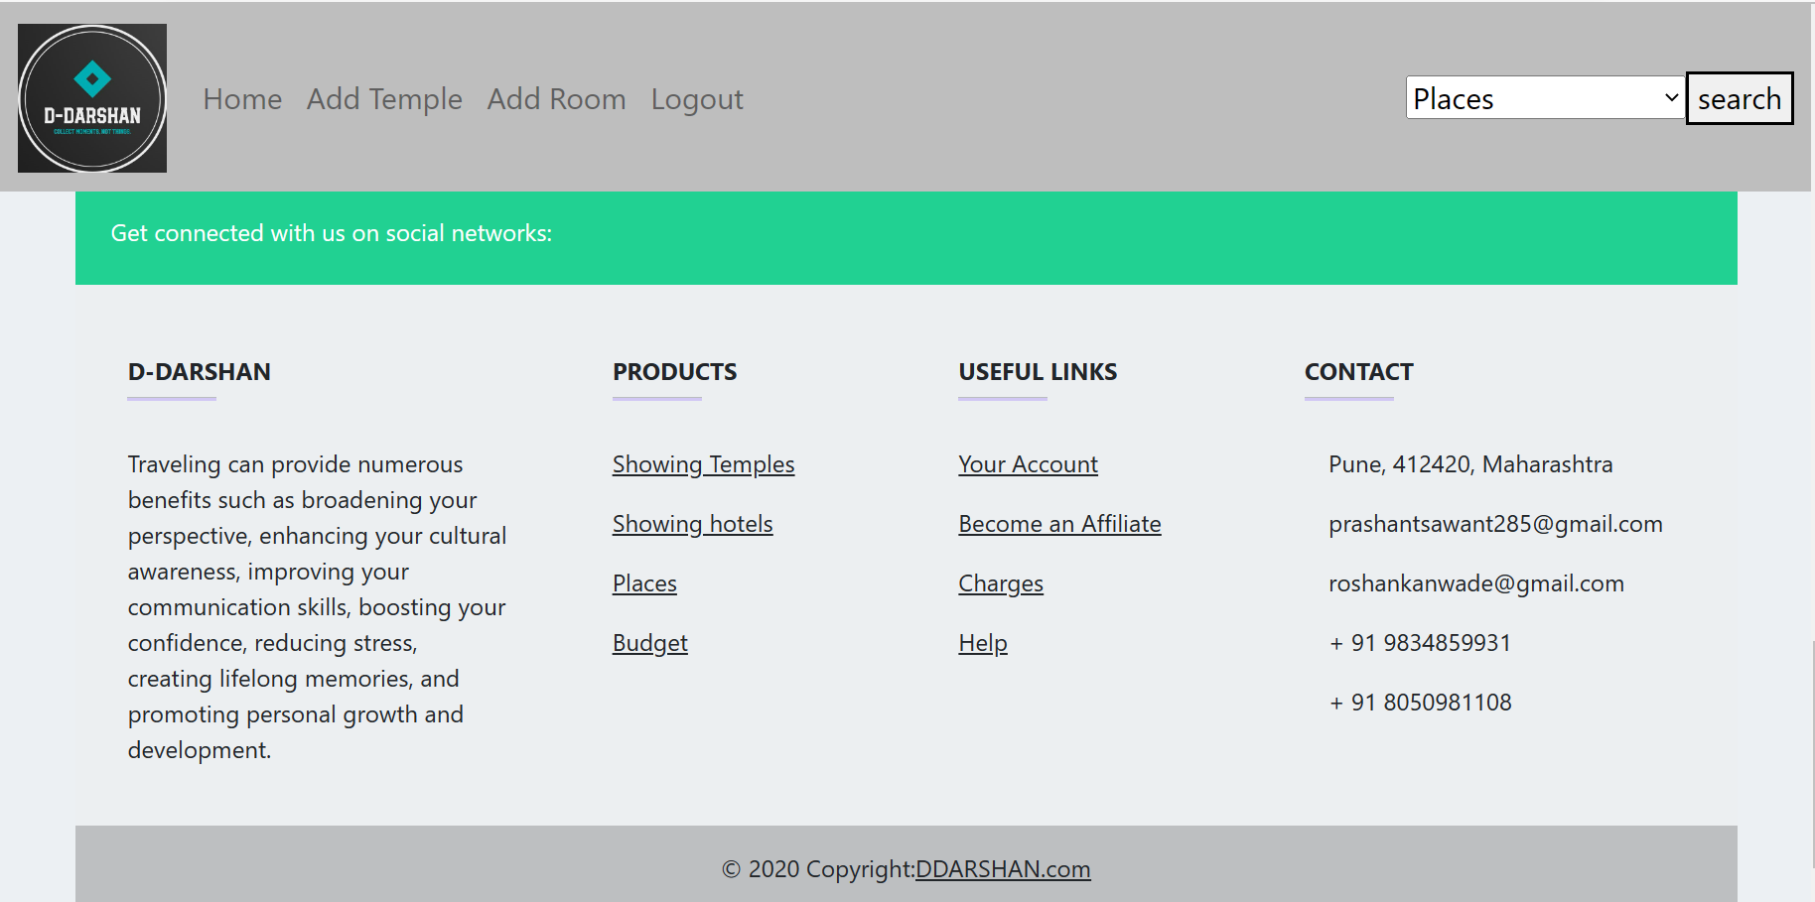

Slide 25
Conclusion: The project entitled D-DARSHAN was completed successfully. The system has been developed with much care and free of errors and at the same time it is efficient and less time consuming. The purpose of this project was to develop a web application for booking hotels near temples. Booking a hotel near temples can be a convenient option for travelers looking to explore and experience the cultural and religious significance of these places. Staying near a temple allows for easy access to the site, which can save time and provide a unique opportunity to witness the rituals and customs of the local community. This project helped us in gaining valuable information and practical knowledge on several topics like designing web pages using React.js, usage of responsive templates, designing of web application, and management of database using MySQL. The entire system is secured. Also, the project helped us understanding about the development phases of a project and software development life cycle. We learned how to test different features of a project.

Slide 26
REFERENCES
JavaScript Enlightenment, Cody Lindley-First Edition, based on JavaScript 1.5, ECMA-262, Edition .
Mc Graw Hill’s, Java: The complete reference 7thEdition, Herbert Scheldt .
Complete CSS Guide, Maxine Sherrin and John Allsopp-O'ReillyMedia; September 2012 .
ONLINE REFERENCE :
www.Google.com
www.w3school.com
www.javatpoint.com
www.gfg.com

Slide 27
THANK YOU

